Slide 1

DO NOW
Would you consider the wheel to be a technological breakthrough? Why or not?

Slide 2
TECHNOLOGY THAT REVOLUTIONIZED MEDICINE

Slide 3
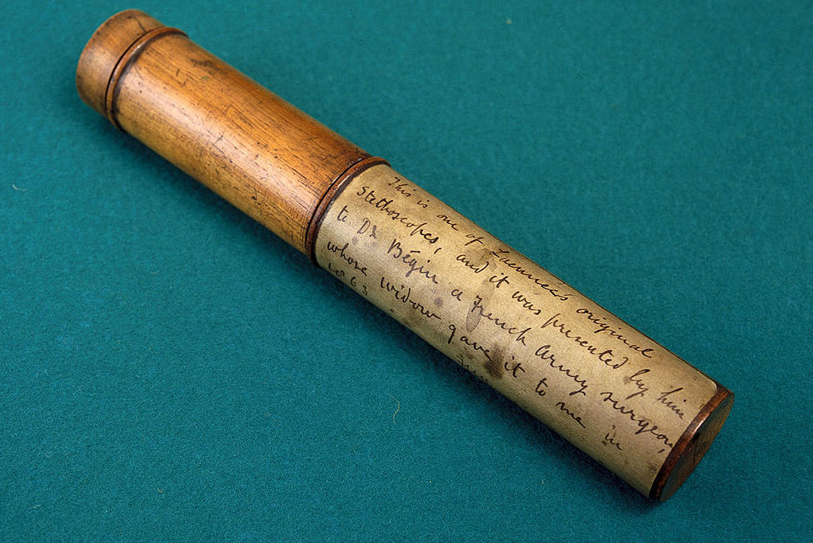
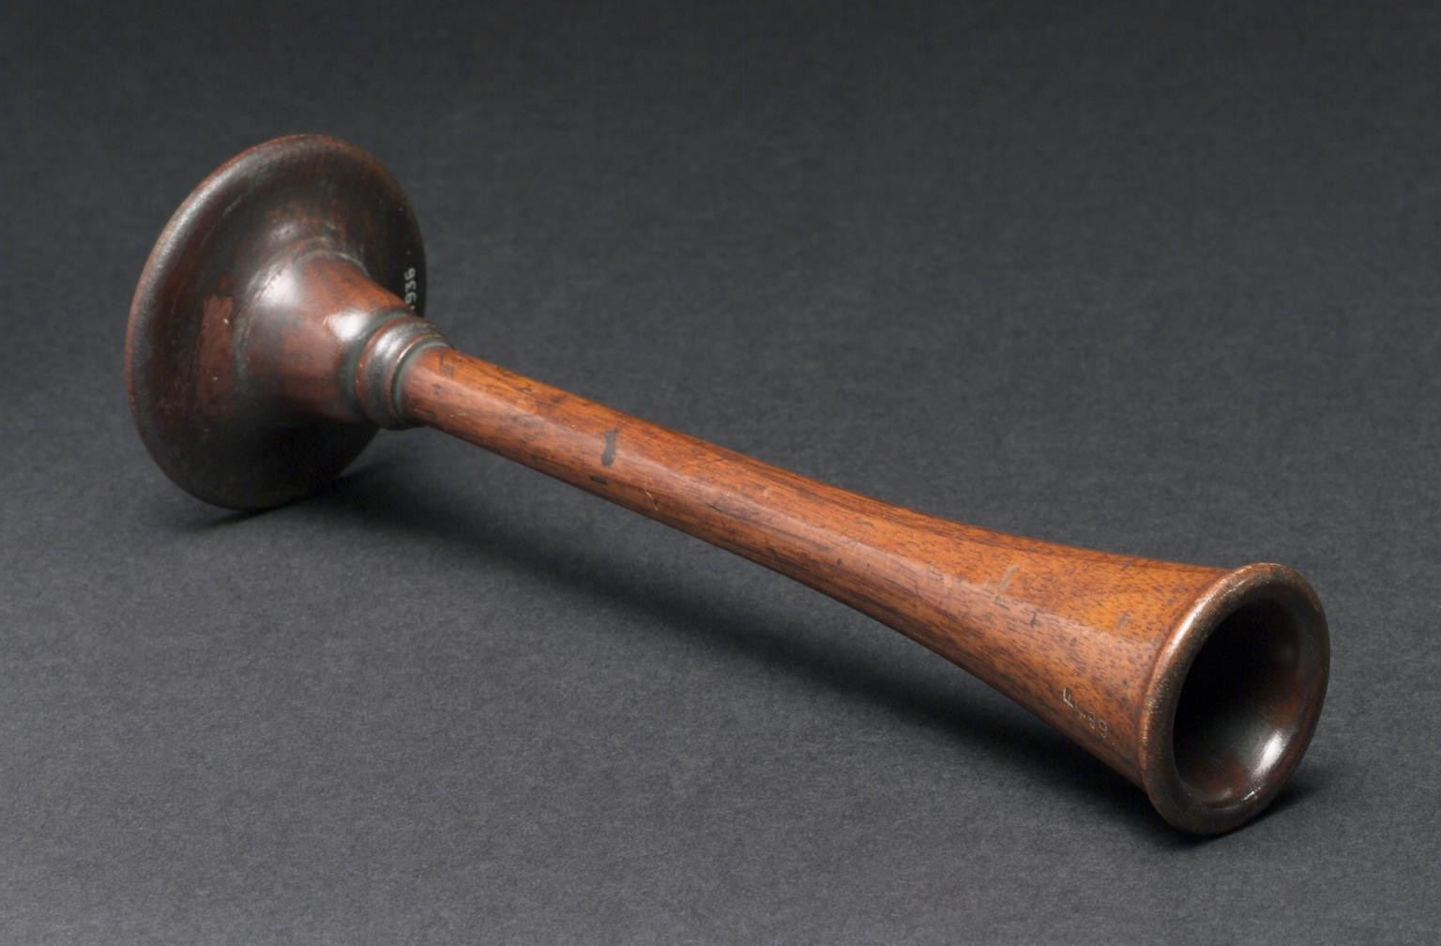
WHAT ARE THESE?

Slide 4
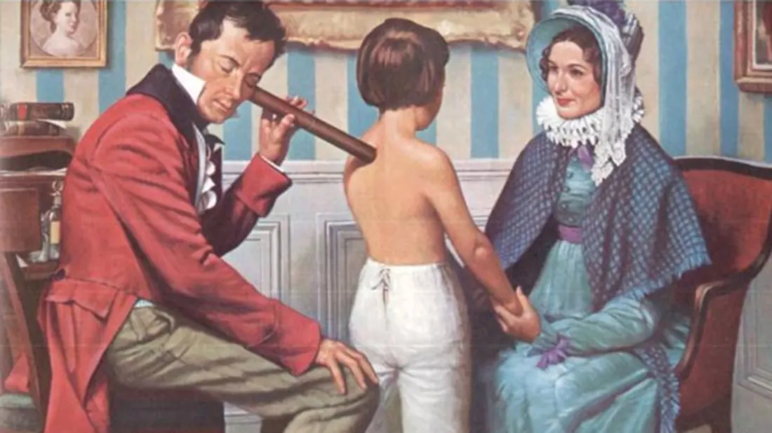


Slide 5
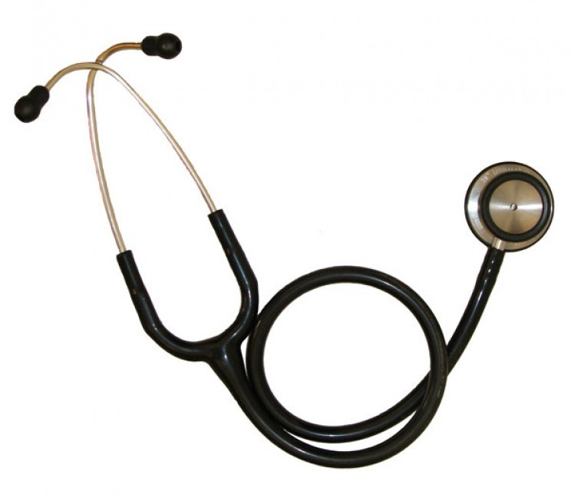
STETHOSCOPE

Slide 6
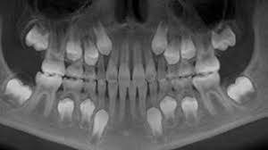
WHAT IS THIS?

Slide 7
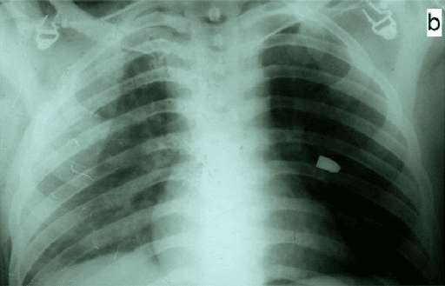

X-RAYS

Slide 8
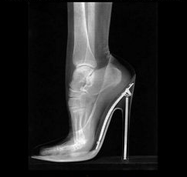


Slide 9
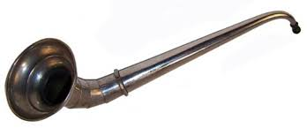
WHAT IS THIS?

Slide 10
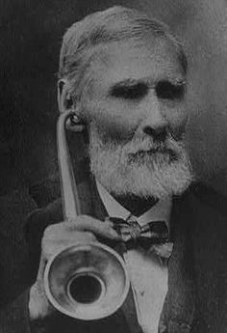
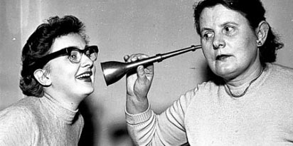
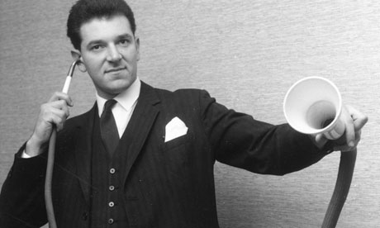
HEARING AID

Slide 11
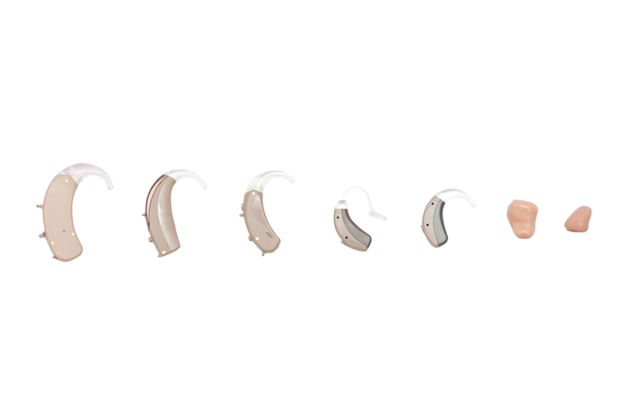


Slide 12
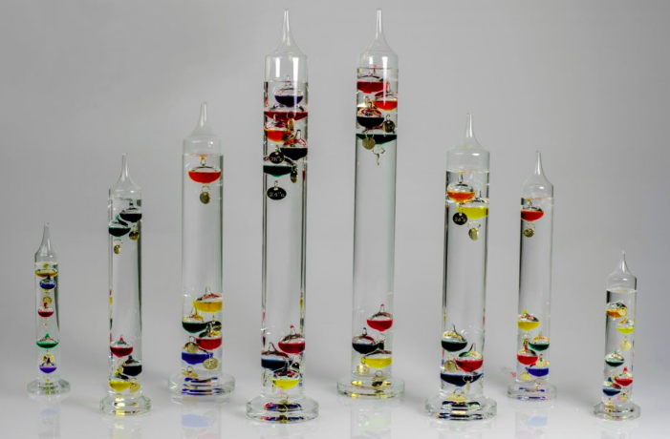
WHAT ARE THESE?

Slide 13
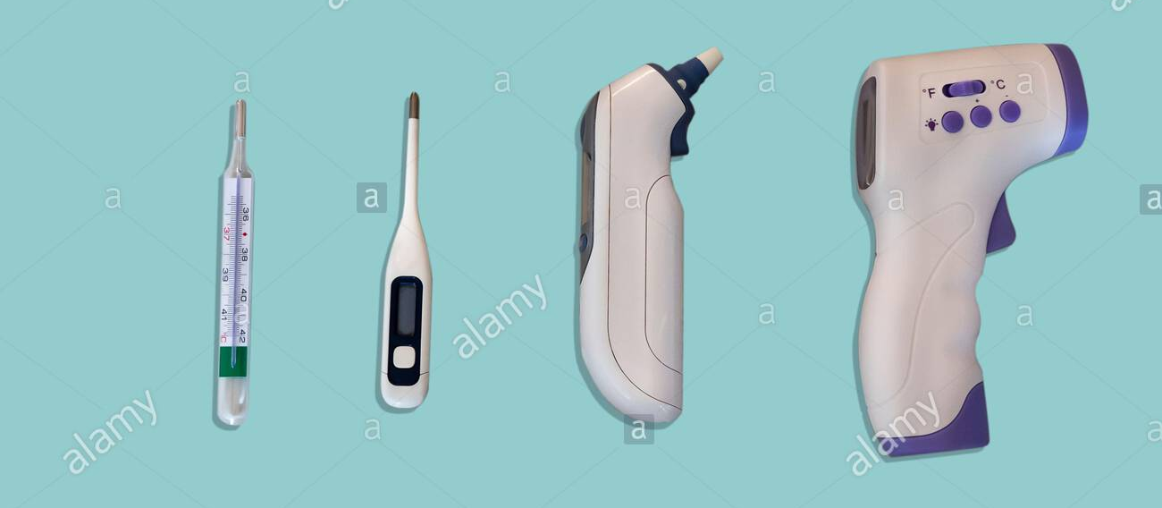

THERMOMETER

Slide 14
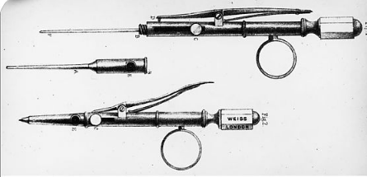
WHAT ARE THESE?

Slide 15

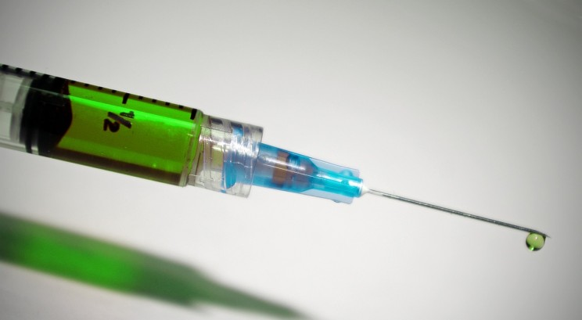
HYPODERMIC NEEDLE

Slide 16
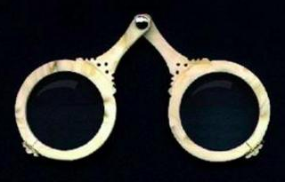
WHAT IS THIS?

Slide 17
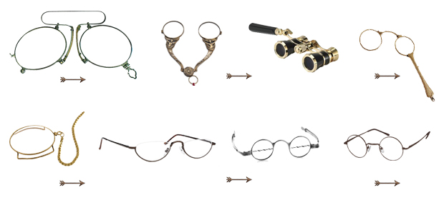
CORRECTIVE LENSES

Slide 18
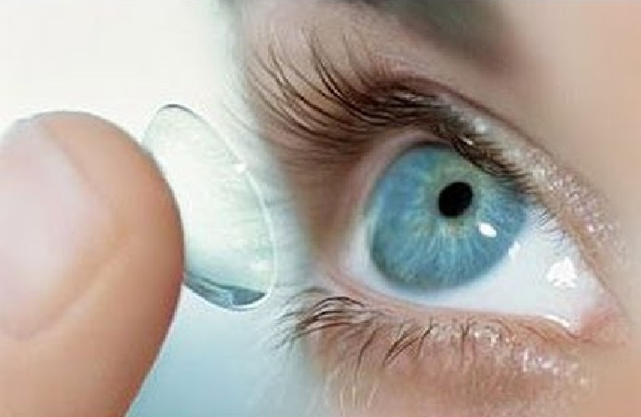
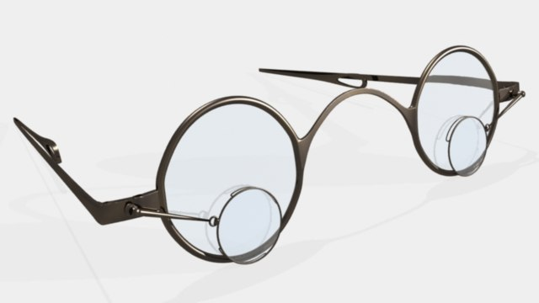
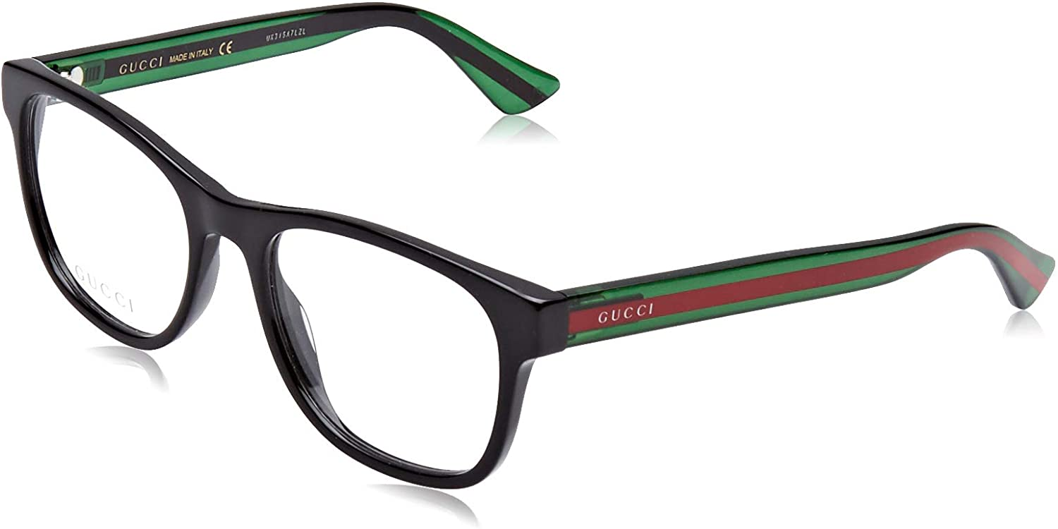


Slide 19
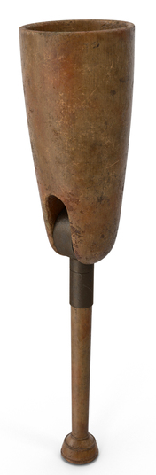
WHAT IS THIS?

Slide 20
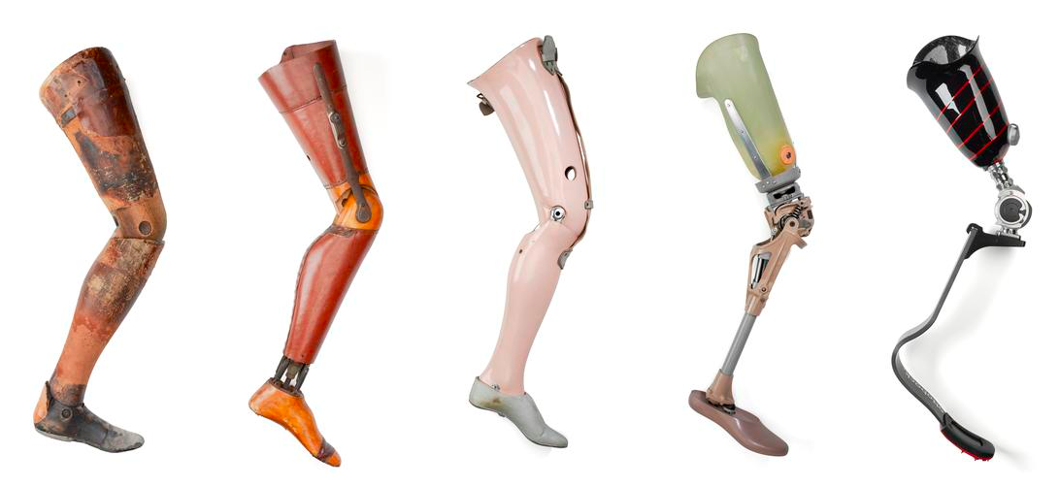
PROSTHETIC (ARTIFICIAL LIMB)

Slide 21
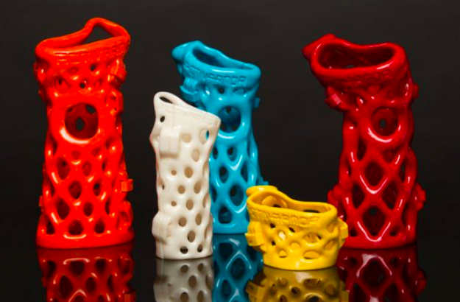
WHAT ARE THESE?

Slide 22
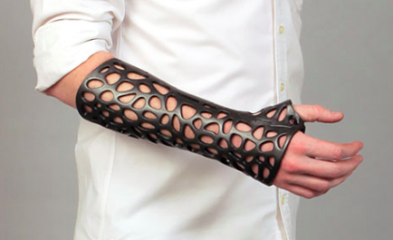
3-D PRINTED CASTS

Slide 23
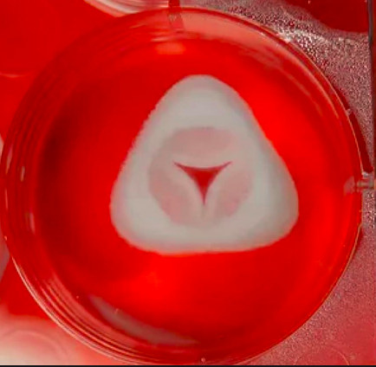

MECHANICAL HEART VALVE

Slide 24



Slide 25
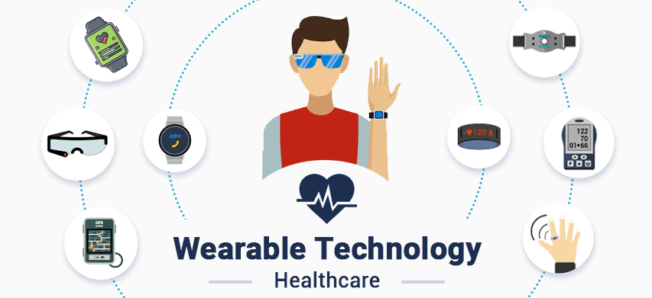

Slide 26
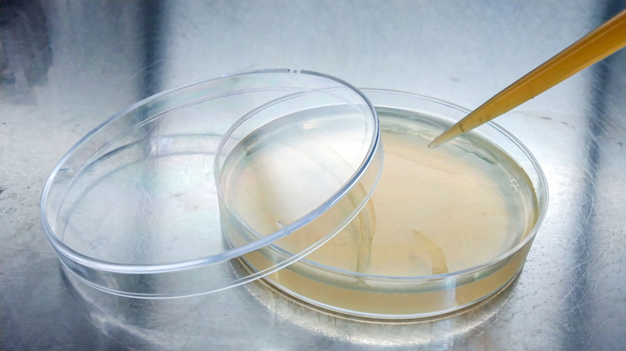
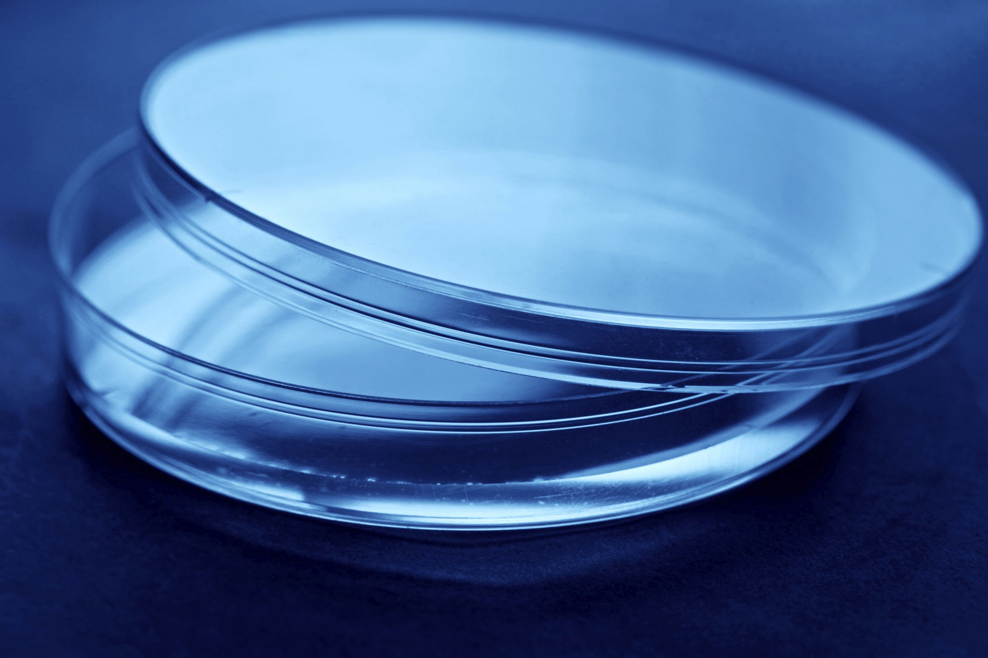
How about this?

Slide 27
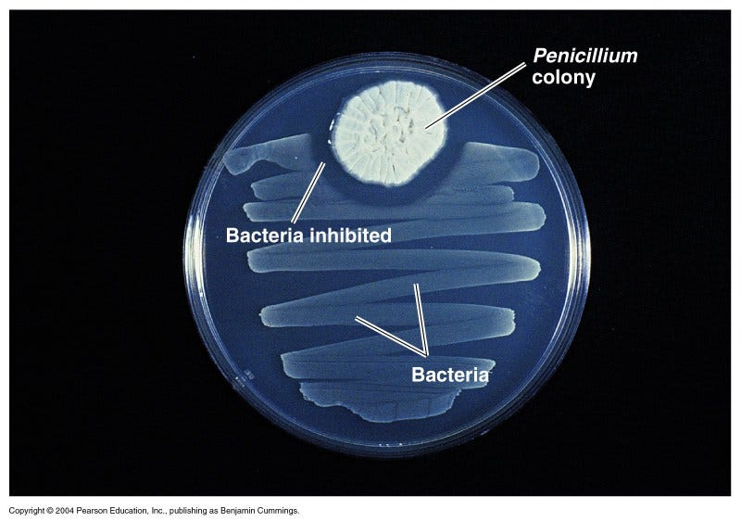
Petrie Dish- Used to culture microbes

Slide 28
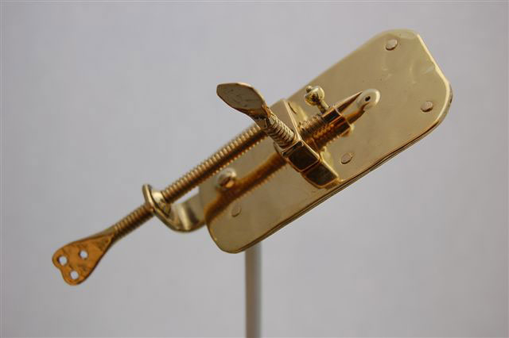
What in the world?

Slide 29

MICROSCOPE!

Slide 30
EXIT TICKET
Answer the following in your JOURNAL:
List TWO pieces of technology or laboratory tests that changed healthcare
For each, briefly explain your reasoning behind your choices.

